Slide 1
Classification: Basic Concepts, Decision Trees

Slide 2
Classification Learning: Definition
Given a collection of records (training set)
Each record contains a set of attributes, one of the attributes is the class
Find a model for the class attribute as a function of the values of the other attributes
Goal: previously unseen records should be assigned a class as accurately as possible
Use test set to estimate the accuracy of the model
Often, the given data set is divided into training and test sets, with training set used to build the model and test set used to validate it

Slide 3
Illustrating Classification Learning

Slide 4

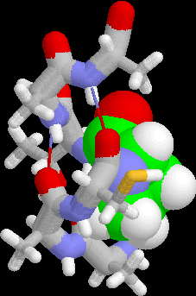
Examples of Classification Task
Predicting tumor cells as benign or malignant
Classifying credit card transactions as legitimate or fraudulent
Classifying secondary structures of protein as alpha-helix, beta-sheet, or random coil
Categorizing news stories as finance, weather, entertainment, sports, etc.

Slide 5
Classification Learning Techniques
Decision tree-based methods
Rule-based methods
Instance-based methods
Probability-based methods
Neural networks
Support vector machines
Logic-based methods

Slide 6
Example of a Decision Tree
Refund
Yes
No
NO
MarSt
Single, Divorced
Married
TaxInc
NO
< 80K
> 80K
NO
YES
Training Data
Model: Decision Tree

Slide 7
Apply Model to Test Data
Test Data
Start at the root of tree
Refund
Yes
No
NO
MarSt
Single, Divorced
Married
TaxInc
NO
< 80K
> 80K
NO
YES

Slide 8
Apply Model to Test Data
Test Data
Refund
Yes
No
NO
MarSt
Single, Divorced
Married
TaxInc
NO
< 80K
> 80K
NO
YES

Slide 9
Apply Model to Test Data
Test Data
Refund
Yes
No
NO
MarSt
Single, Divorced
Married
TaxInc
NO
< 80K
> 80K
NO
YES

Slide 10
Apply Model to Test Data
Test Data
Refund
Yes
No
NO
MarSt
Single, Divorced
Married
TaxInc
NO
< 80K
> 80K
NO
YES

Slide 11
Apply Model to Test Data
Test Data
Refund
Yes
No
NO
MarSt
Single, Divorced
Married
TaxInc
NO
< 80K
> 80K
NO
YES

Slide 12
Apply Model to Test Data
Test Data
Refund
Yes
No
NO
MarSt
Single, Divorced
Married
Assign Cheat to “No”
TaxInc
NO
< 80K
> 80K
NO
YES

Slide 13
Decision Tree Learning: ID3
Function ID3(Training-set, Attributes)
If all elements in Training-set are in same class, then return leaf node labeled with that class
Else if Attributes is empty, then return leaf node labeled with majority class in Training-set
Else if Training-Set is empty, then return leaf node labeled with default majority class
Else
Select and remove A from Attributes
Make A the root of the current tree
For each value V of A
Create a branch of the current tree labeled by V
Partition_V ← Elements of Training-set with value V for A
Induce-Tree(Partition_V, Attributes)
Attach result to branch V

Slide 14
Illustrative Training Set

Slide 15
ID3 Example (I)

Slide 16
ID3 Example (II)

Slide 17
ID3 Example (III)

Slide 18
Another Example
Assume A₁ is binary feature (Gender: M/F)
Assume A₂ is nominal feature (Color: R/G/B)
A₁
A₂
R
G
B
A₂
R
G
B
A₁
M F
A₂
Decision surfaces are axis-aligned Hyper-rectangles
A₁
M F

Slide 19
Non-Uniqueness
Decision trees are not unique:
Given a set of training instances T, there generally exists a number of decision trees that are consistent with (or fit) T
MarSt
Single, Divorced
Married
NO
Refund
Yes
No
NO
TaxInc
< 80K
> 80K
NO
YES

Slide 20
ID3’s Question
Given a training set, which of all of the decision trees consistent with that training set should we pick?
More precisely:
Given a training set, which of all of the decision trees consistent with that training set has the greatest likelihood of correctly classifying unseen instances of the population?

Slide 21
ID3’s (Approximate) Bias
ID3 (and family) prefers simpler decision trees
Occam’s Razor Principle:
“It is vain to do with more what can be done with less...Entities should not be multiplied beyond necessity.”
Intuitively:
Always accept the simplest answer that fits the data, avoid unnecessary constraints
Simpler trees are more general

Slide 22
ID3’s Question Revisited
Since ID3 builds a decision tree by recursively selecting attributes and splitting the training data based on the values of these attributes
Practically:
Given a training set, how do we select attributes so that the resulting tree is as small as possible, i.e. contains as few attributes as possible?

Slide 23
Not All Attributes Are Created Equal
Each attribute of an instance may be thought of as contributing a certain amount of information to its classification
Think 20-Questions:
What are good questions?
Ones whose answers maximize information gained
For example, determine shape of an object:
Num. sides contributes a certain amount of information
Color contributes a different amount of information
ID3 measures information gained by making each attribute the root of the current subtree, and subsequently chooses the attribute that produces the greatest information gain

Slide 24
Entropy (as information)
Entropy at a given node t:
(where p( j | t) is the relative frequency of class j at node t)
Based on Shannon’s information theory
For simplicity, assume only 2 classes Yes and No
Assume t is a set of messages sent to a receiver that must guess their class
If p( Yes | t )=1 (resp., p( No | t )=1), then the receiver guesses a new example as Yes (resp., No). No message need be sent.
If p( Yes | t )=p( No | t )=0.5, then the receiver cannot guess and must be told the class of a new example. A 1-bit message must be sent.
If 0<p( Yes | t )<1, then the receiver needs less than 1 bit on average to know the class of a new example.

Slide 25
Entropy (as homogeneity)
Think chemistry/physics
Entropy is measure of disorder or homogeneity
Minimum (0.0) when homogeneous / perfect order
Maximum (1.0, in general log C) when most heterogeneous / complete chaos
In ID3
Minimum (0.0) when all records belong to one class, implying most information
Maximum (log C) when records are equally distributed among all classes, implying least information
Intuitively, the smaller the entropy the purer the partition

Slide 26
Examples of Computing Entropy
P(C1) = 0/6 = 0 P(C2) = 6/6 = 1
Entropy = – 0 log 0 – 1 log 1 = – 0 – 0 = 0
P(C1) = 1/6 P(C2) = 5/6
Entropy = – (1/6) log₂ (1/6) – (5/6) log₂ (1/6) = 0.65
P(C1) = 2/6 P(C2) = 4/6
Entropy = – (2/6) log₂ (2/6) – (4/6) log₂ (4/6) = 0.92

Slide 27
Information Gain
Information Gain:
(where parent Node, p is split into k partitions, and
n_{i} is number of records in partition i)
Measures reduction in entropy achieved because of the split ➔ maximize
ID3 chooses to split on the attribute that results in the largest reduction, i.e, (maximizes GAIN)
Disadvantage: Tends to prefer splits that result in large number of partitions, each being small but pure.

Slide 28
Computing Gain
Before Splitting:
E0
A?
B?
Yes
No
Yes
No
Node N1
Node N2
Node N3
Node N4
E1
E2
E3
E4
E12
E34
Gain = E0 – E12 vs. E0 – E34

Slide 29
Gain Ratio
Gain Ratio:
(where parent Node, p is split into k partitions, and
n_{i} is number of records in partition i)
Designed to overcome the disadvantage of GAIN
Adjusts GAIN by the entropy of the partitioning (SplitINFO)
Higher entropy partitioning (large number of small partitions) is penalized
Used by C4.5 (an extension of ID3)

Slide 30
Other Splitting Criterion: GINI Index
GINI Index for a given node t :
Maximum (1 - 1/n_{c}) when records are equally distributed among all classes, implying least interesting information
Minimum (0.0) when all records belong to one class, implying most interesting information
Minimize GINI split value
Used by CART, SLIQ, SPRINT

Slide 31
How to Specify Test Condition?
Depends on attribute types
Nominal
Ordinal
Continuous
Depends on number of ways to split
Binary split
Multi-way split

Slide 32
Splitting Based on Nominal Attributes
Multi-way split: Use as many partitions as values
Binary split: Divide values into two subsets
CarType
Family
Luxury
Sports
CarType
CarType
{Sports, Luxury}
OR
{Family, Luxury}
{Family}
{Sports}
Need to find optimal partitioning!

Slide 33
Splitting Based on Continuous Attributes
Different ways of handling
Multi-way split: form ordinal categorical attribute
Static – discretize once at the beginning
Dynamic – repeat on each new partition
Binary split: (A < v) or (A ≥ v)
How to choose v?
Need to find optimal partitioning!
Can use GAIN or GINI !

Slide 34
Overfitting and Underfitting
Overfitting:
Given a model space H, a specific model h∈H is said to overfit the training data if there exists some alternative model h’∈H, such that h has smaller error than h’ over the training examples, but h’ has smaller error than h over the entire distribution of instances
Underfitting:
The model is too simple, so that both training and test errors are large

Slide 35
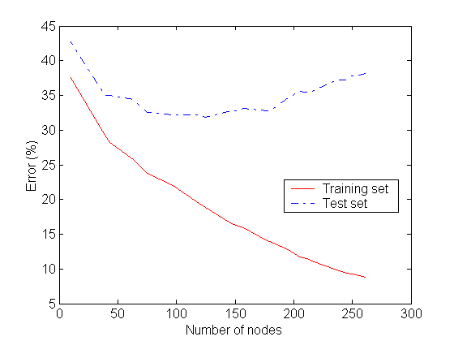
Detecting Overfitting
Overfitting

Slide 36
Overfitting in Decision Tree Learning
Overfitting results in decision trees that are more complex than necessary
Tree growth went too far
Number of instances gets smaller as we build the tree (e.g., several leaves match a single example)
Training error no longer provides a good estimate of how well the tree will perform on previously unseen records

Slide 37
Avoiding Tree Overfitting – Solution 1
Pre-Pruning (Early Stopping Rule)
Stop the algorithm before it becomes a fully-grown tree
Typical stopping conditions for a node:
Stop if all instances belong to the same class
Stop if all the attribute values are the same
More restrictive conditions:
Stop if number of instances is less than some user-specified threshold
Stop if class distribution of instances are independent of the available features (e.g., using χ ² test)
Stop if expanding the current node does not improve impurity measures (e.g., GINI or GAIN)

Slide 38
Avoiding Tree Overfitting – Solution 2
Post-pruning
Split dataset into training and validation sets
Grow full decision tree on training set
While the accuracy on the validation set increases:
Evaluate the impact of pruning each subtree, replacing its root by a leaf labeled with the majority class for that subtree
Replace subtree that most increases validation set accuracy (greedy approach)

Slide 39
Decision Tree Based Classification
Advantages:
Inexpensive to construct
Extremely fast at classifying unknown records
Easy to interpret for small-sized trees
Good accuracy (careful: NFL)
Disadvantages:
Axis-parallel decision boundaries
Redundancy
Need data to fit in memory
Need to retrain with new data

Slide 40
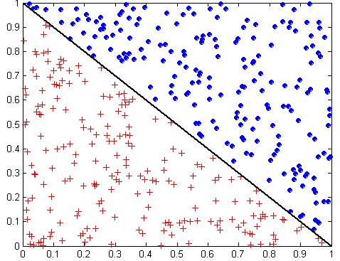
Oblique Decision Trees
x + y < 1
Class = +
Class =
Test condition may involve multiple attributes
More expressive representation
Finding optimal test condition is computationally expensive

Slide 41
Subtree Replication
Same subtree appears in multiple branches

Slide 42
Decision Trees and Big Data
For each node in the decision tree we need to scan the entire data set
Could just do multiple MapReduce steps across the entire data set
Ouch!
Have each processor build a decision tree based on local data
Combine decision trees
Better?

Slide 43
Combining Decision Trees
Meta Decision Tree
Somehow decide which decision tree to use
Hierarchical
More training needed
Voting
Run classification data through all decision trees and then vote
Merge Decision Trees

